Slide 1
Mask R-CNN
Donghwa KIM

Slide 2
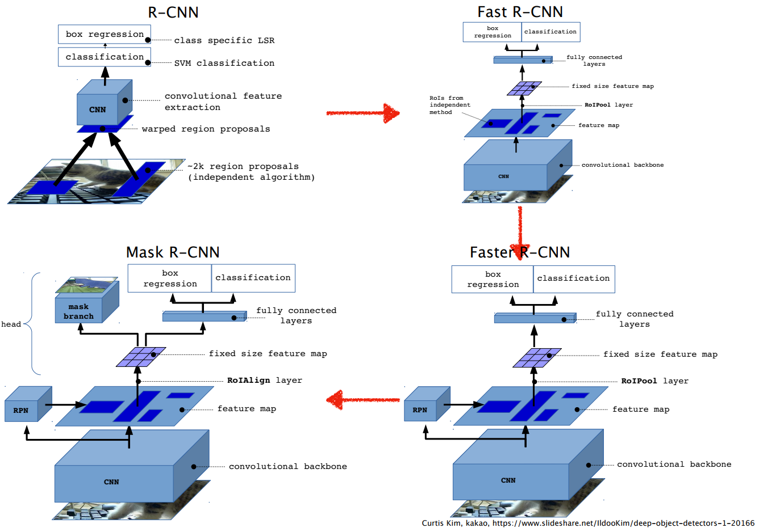
Big Picture

Slide 3
Mask R-CNN이란?
Faster R-CNN:
+ {Object -> branch}
box bounding를 인지/ RoI의 마스크를 예측
Simple

Slide 4
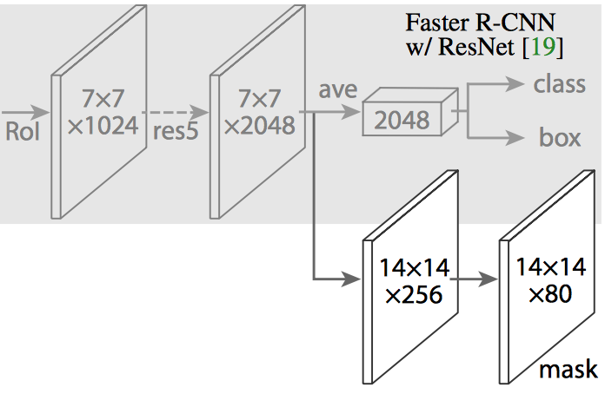
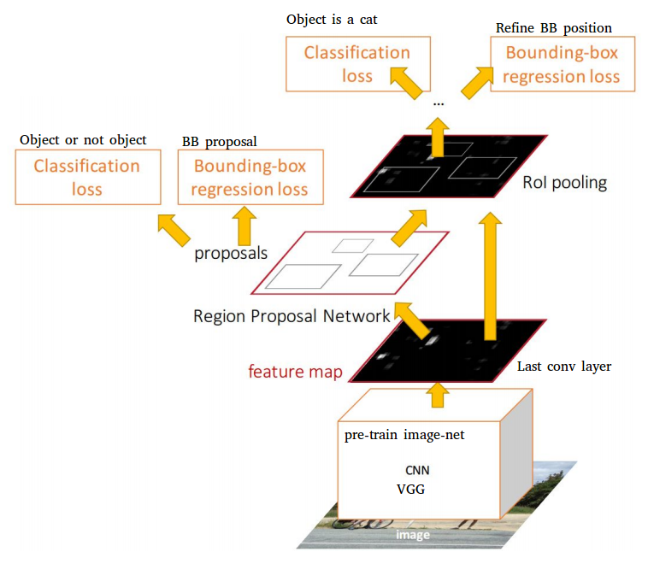
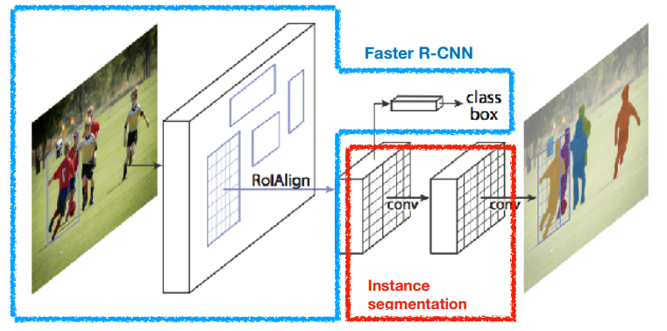
Mask R-CNN이란?
<Faster R-CNN>
<Mask R-CNN>

Slide 5
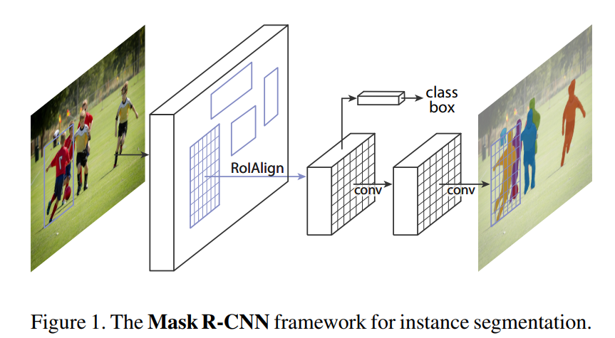
Mask R-CNN 무엇이 특별한가?
RoIAlign
decouple
RoIAlign
Coarse spatial quantization for feature extraction
Preserves exact spatial locations
Improve mask accuracy (10% ->50%)
decouple mask & class prediction
Binary mask(one-hot)는 class와 독립적
Mask R-CNN | FCN
decouple | couple
세그먼트와 분류문제를 따로 | 세그먼트와 분류문제를 함께

Slide 6
과거의 연구들
R-CNN
Candidate object regions
각 regions들과 독립적인 CNN
Faster R-CNN
Attention mechanism :Region Proposal Network
Instance segmentation
Segment proposals by Fast R-CNN (slow and less accurate)
Segment proposals from BB+ classification (complex)
FCN (errors on overlapping instance)

Slide 7
과거의 연구들
R-CNN
Candidate object regions
각 regions들과 독립적인 CNN
Faster R-CNN
Attention mechanism :Region Proposal Network
Instance segmentation
Segment proposals by Fast R-CNN (slow and less accurate)
Segment proposals from BB+ classification (complex)
FCIS (errors on overlapping instance)

Slide 8
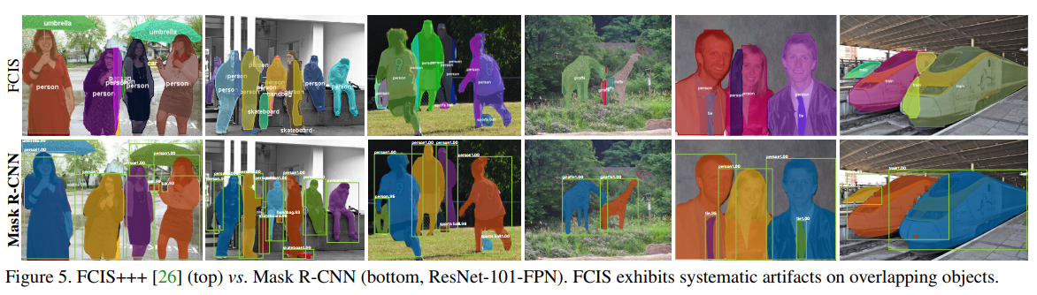
과거의 연구들
FCIS (errors on overlapping instance)

Slide 9
Mask R-CNN
Output
Faster
R-CNN
Class label
Bounding box offset
Mask
R-CNN
Class label
Bounding box offset
Object mask

Slide 10

Mask R-CNN
Output
Faster
R-CNN
Class label
Bounding box offset
Mask
R-CNN
Class label
Bounding box offset
Branch
Object mask

Slide 11
Mask R-CNN
Output
Faster
R-CNN
Class label
Bounding box offset
Class label
Independent
Mask
R-CNN
Bounding box offset
Object mask

Slide 12
Mask R-CNN
Output
Faster
R-CNN
Class label
Bounding box offset
Mask
R-CNN
Class label
Bounding box offset
Object mask
Pixel to pixel alignment

Slide 13
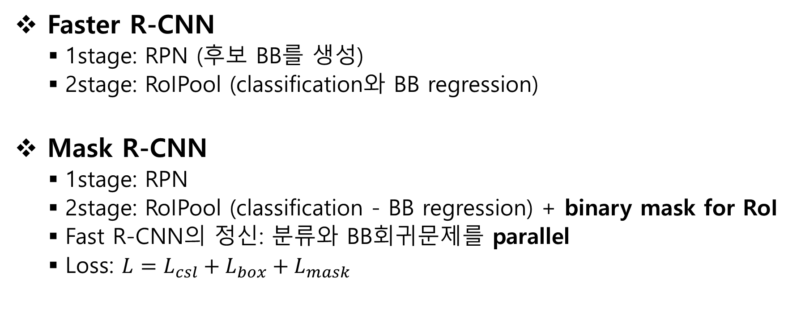
Mask R-CNN
Faster R-CNN
1stage: RPN (후보 BB를 생성)
2stage: RoIPool (classification와 BB regression)
Mask R-CNN
1stage: RPN
2stage: RoIPool (classification - BB regression) + binary mask for RoI
Fast R-CNN의 정신: 분류와 BB회귀문제를 parallel
Loss: $L=L_{csl}+L_{box}+L_{mask}$

Slide 14
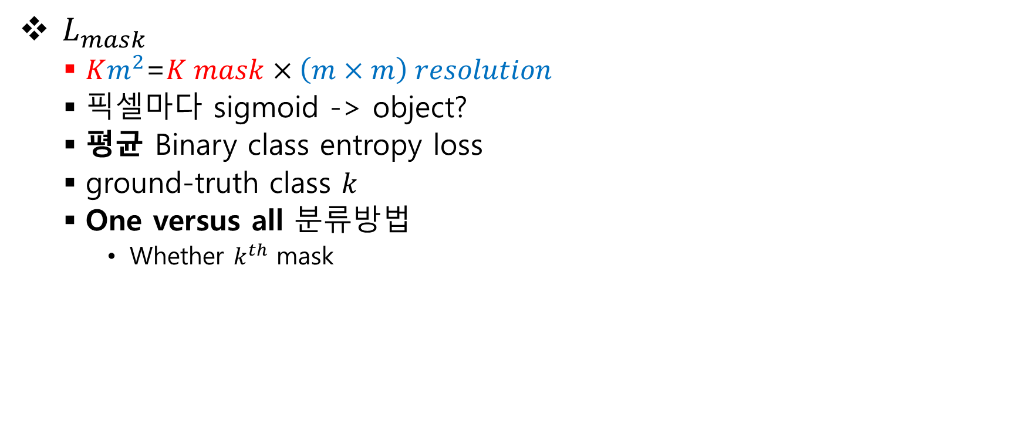
Mask R-CNN
$L_{mask}$
$Km^{2}$=$K mask×\left(m×m\right) resolution$
픽셀마다 sigmoid -> object?
평균 Binary class entropy loss
ground-truth class $k$
One versus all 분류방법
Whether $k^{th}$ mask
Mask R-CNN | FCN
Per-pixel Sigmoid | Per-pixel Softmax
Binary cross-entropy | Multinomial cross-entropy

Slide 15
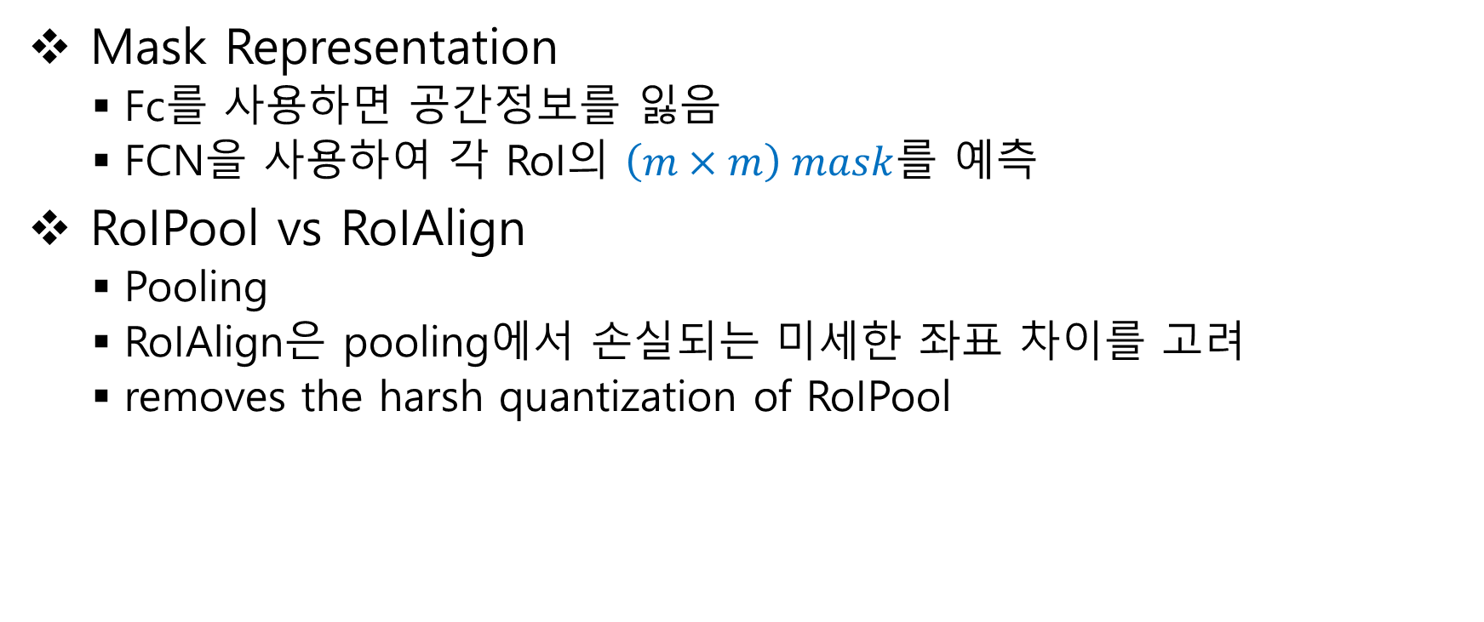
Mask R-CNN
Mask Representation
Fc를 사용하면 공간정보를 잃음
FCN을 사용하여 각 RoI의 $\left(m×m\right) mask$를 예측
RoIPool vs RoIAlign
Pooling
RoIAlign은 pooling에서 손실되는 미세한 좌표 차이를 고려
removes the harsh quantization of RoIPool

Slide 16
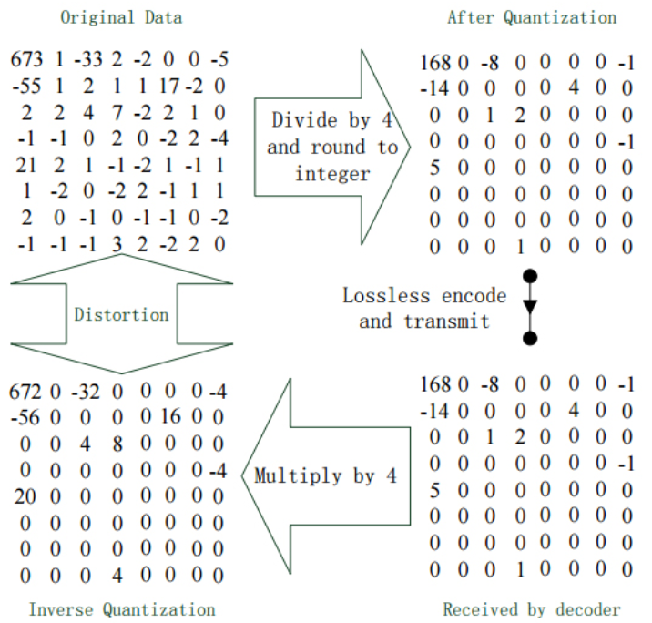
Encoding Technology
quantization
이미지를 데이터로 변환하는 방법에서 쓰이고 있는 방법론
이미지 압축

Slide 17
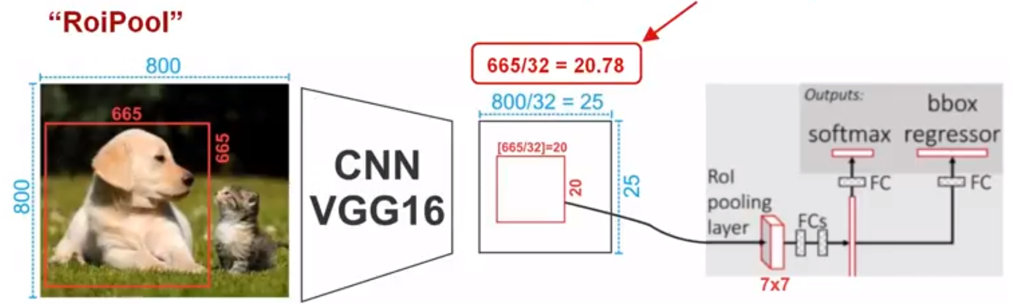
Mask R-CNN

Slide 18
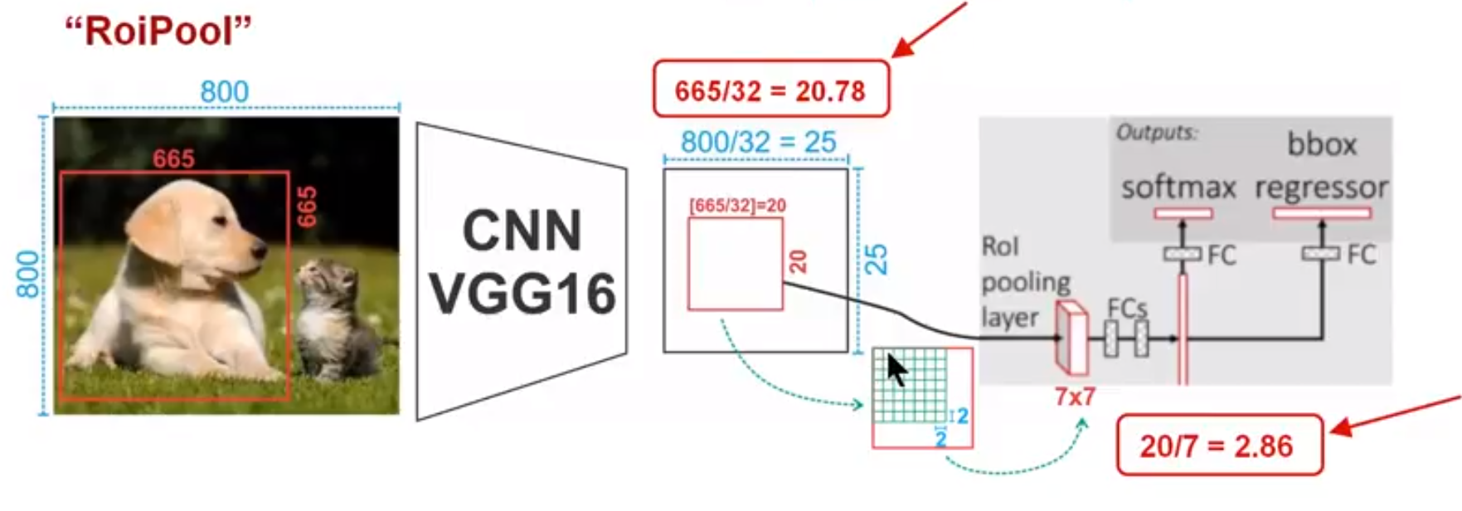
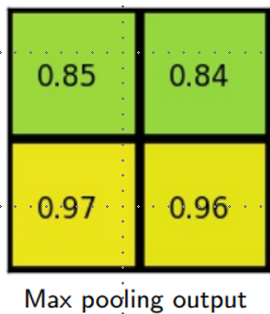
Mask R-CNN

Slide 19

Mask R-CNN

Slide 20
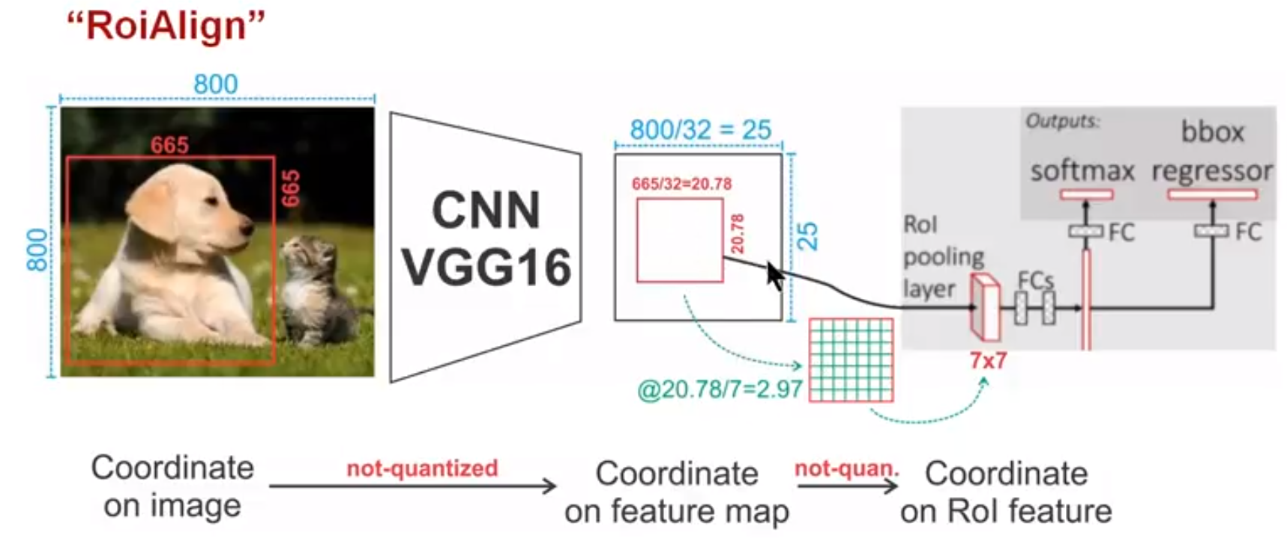
Mask R-CNN

Slide 21
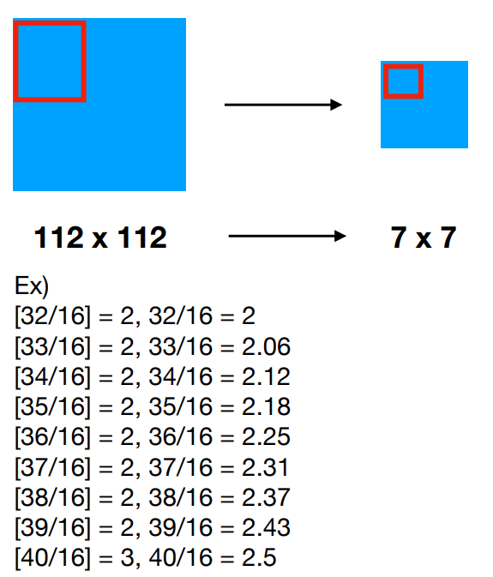
Mask R-CNN
RoIPool
32 = coordinate x
16 = feature map stride

Slide 22
Mask R-CNN
RoIPool
32 = coordinate x
16 = feature map stride
RoIAlign

Slide 23
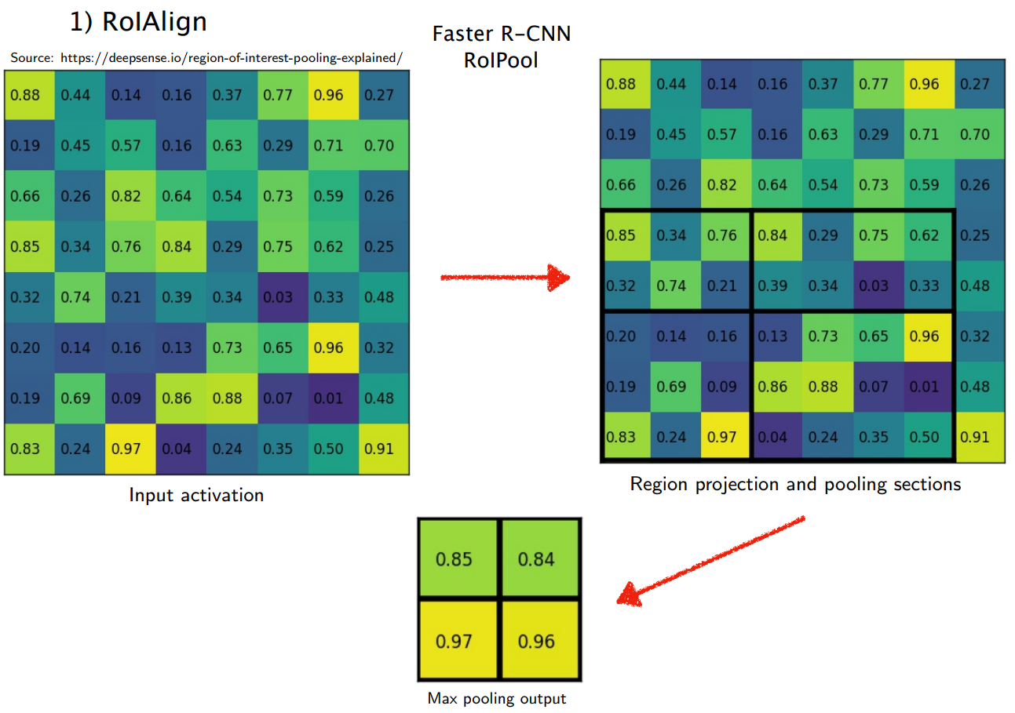
Mask R-CNN
e.g.7x7

Slide 24
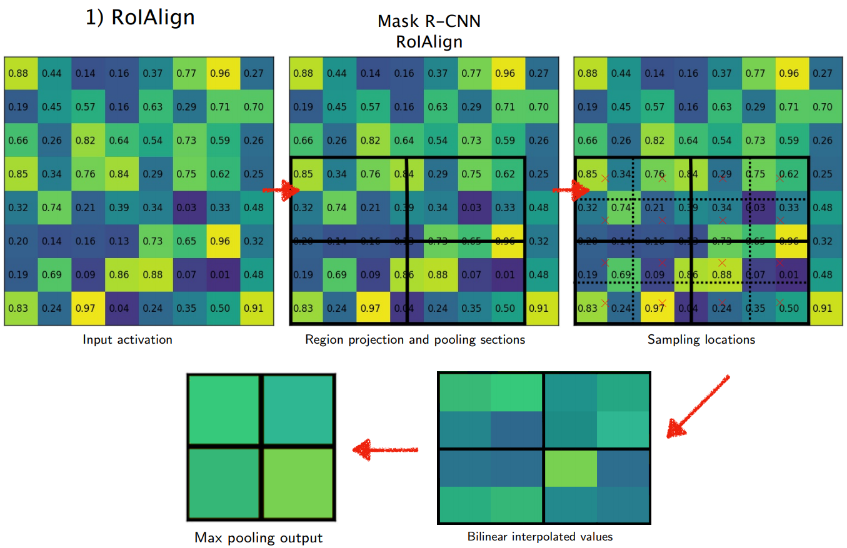
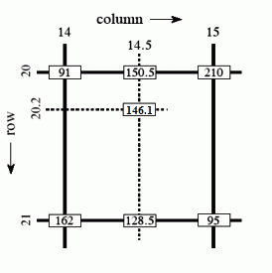
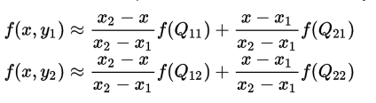
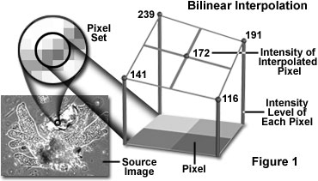
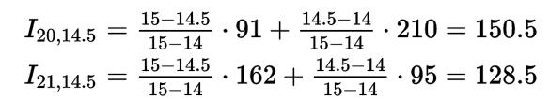
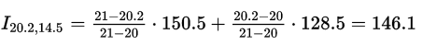
Mask R-CNN

Slide 25
Mask R-CNN
e.g.7x7

Slide 26
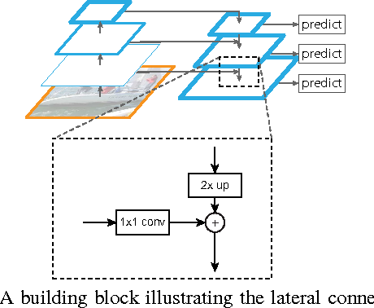
Mask R-CNN
Feature pyramid network

Slide 27
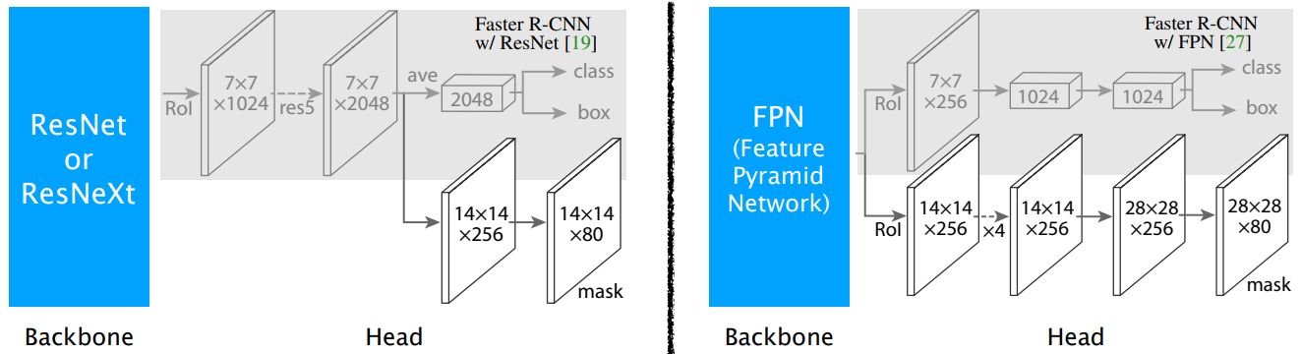
Mask R-CNN

Slide 28
Details
Training
RoI : IoU >= 0.5 for box, mask
resized as 800x800
GPU당 2장의 이미지 배치
각 이미지당 64 or 513 RoI샘플 (P:1, N:3)
Inference
300 / 1000 proposal
Box 예측스코어가 높은 100 boxes를 추림(non-maximum suppression)

Slide 29
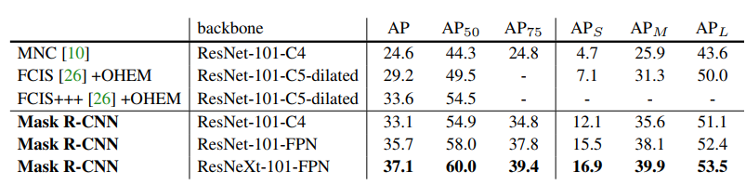
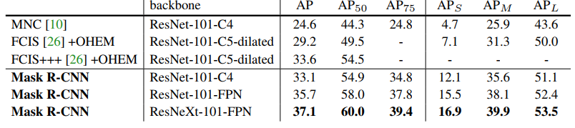
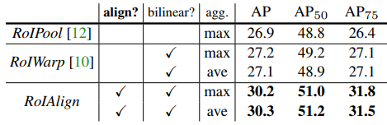
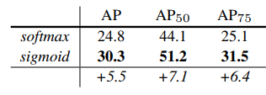
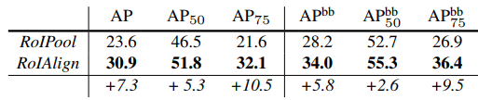
Results

Slide 30
동영상
Mask RCNN COCO Object detection and segmentation

